Slide 1



We cherish every drink moment
KARIM CHOUEIRI
CEO/CO-FOUNDER

Slide 2
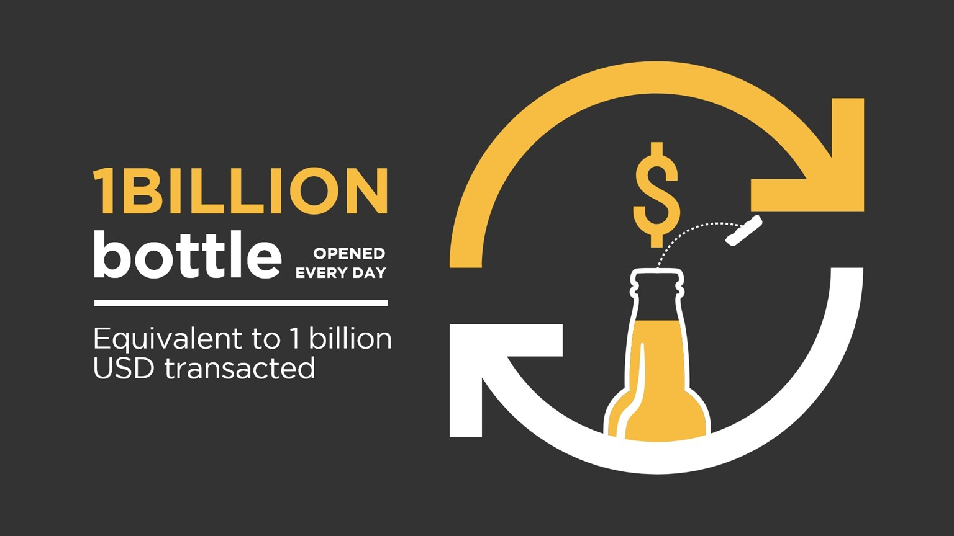


Slide 3

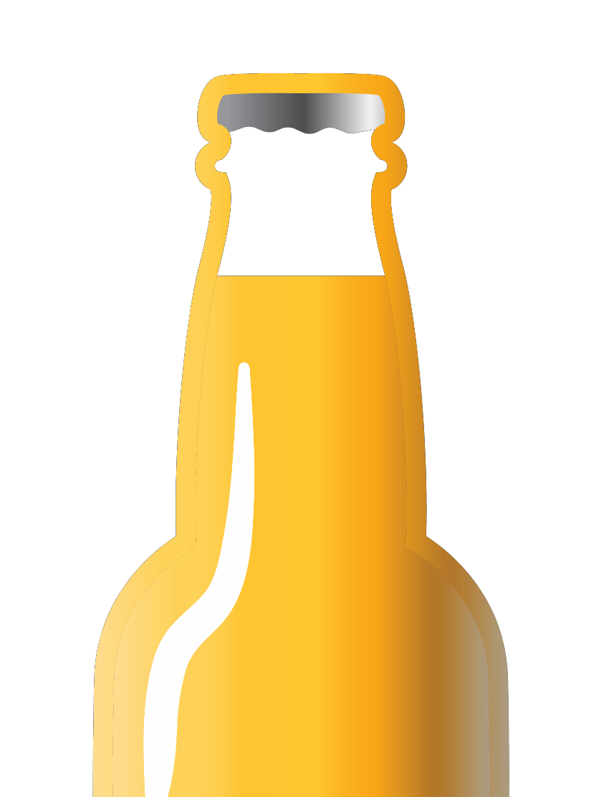
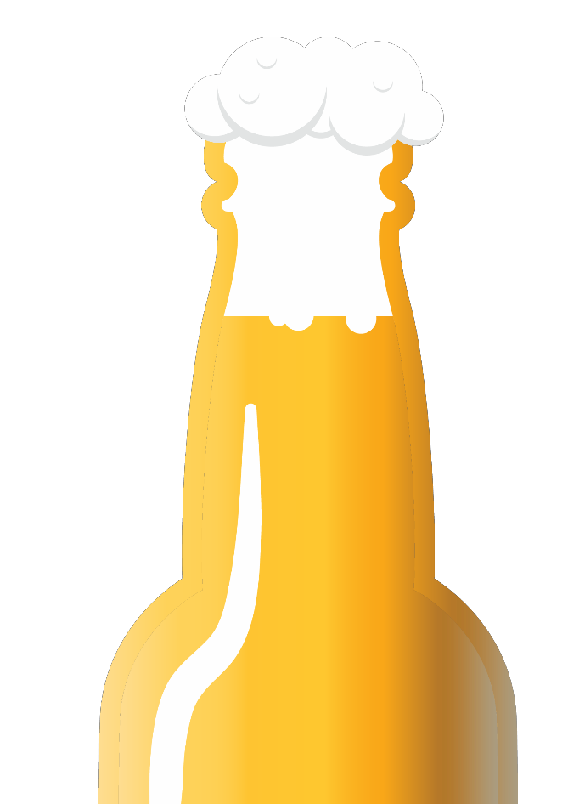
CAPTURE EVERY BOTTLE
Know: Who, Where, When, and What bottle was opened
DIRECTLY INFLUENCE WHAT THEY OPEN NEXT

Slide 4
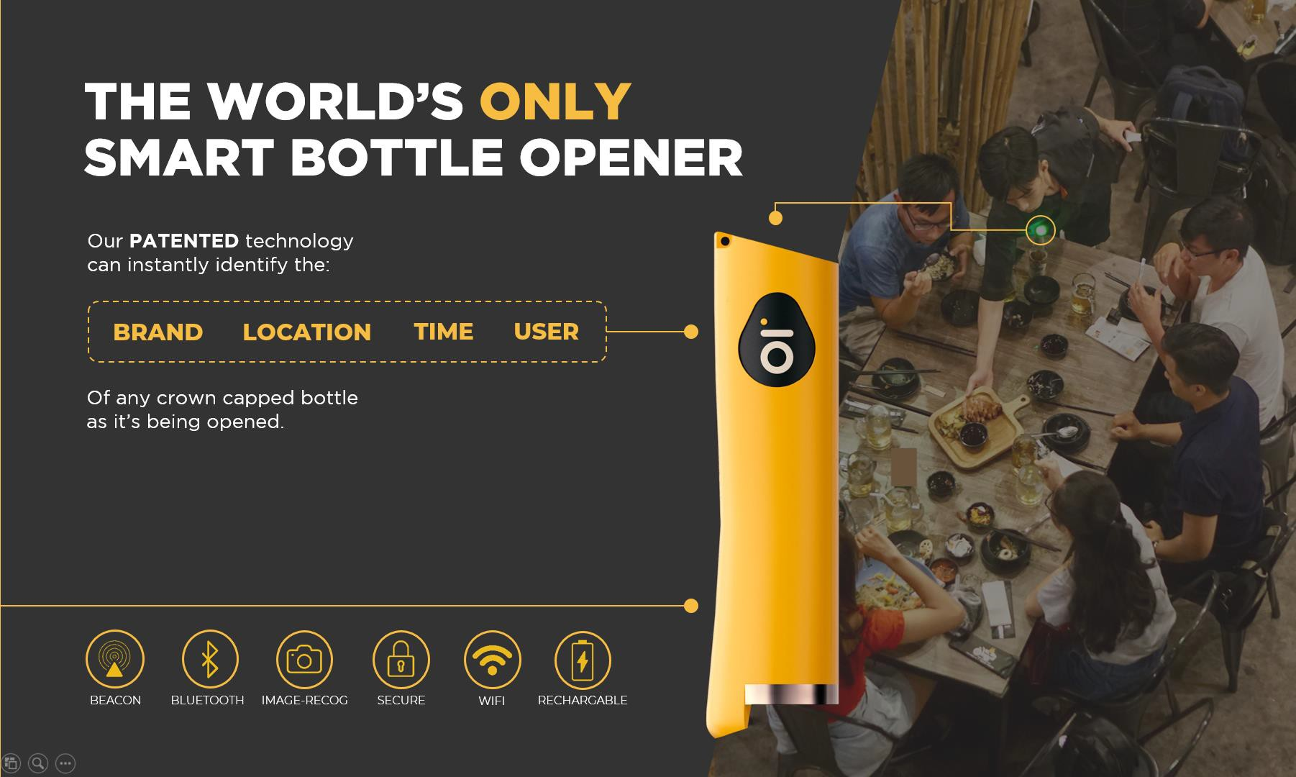

Slide 5



WECHEER INSIGHTS
WECHEER BARTENDER APP
Turn bartenders into
salesmen using WECHEER coins
Real-time
market intelligence

Slide 6






Today: Single brewery model
DISTRIBUTOR
Delivers
BAR MANAGER
Gatekeeper
DISTRIBUTOR
Set Campaigns
BREWERY
Buys Smart Opener
BREWERY
Buys Coins
BARTENDERS

Slide 7
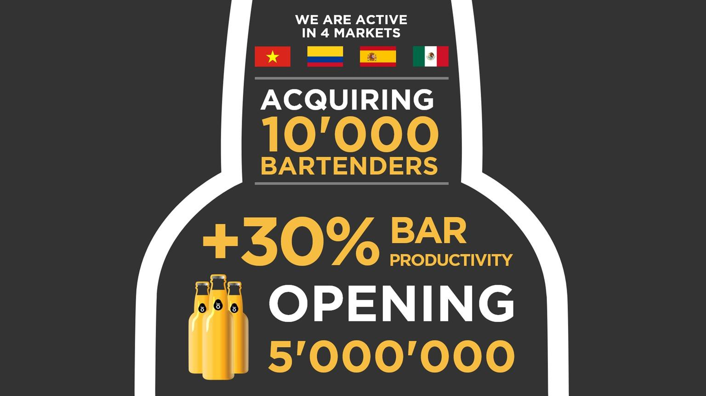

Slide 8















The WECHEER platform improves bartender productivity by +30% helping bar owners to increase total sales & performance of their locations
Without WECHEER
With CHEERCOIN Incentive
13
Bottles
/ Bartender
/ Day
17
Bottles
/ Bartender
/ Day
25
20
17
15
13
10
5
0

Slide 9
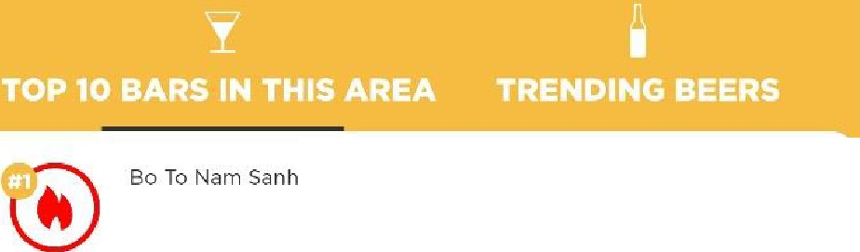
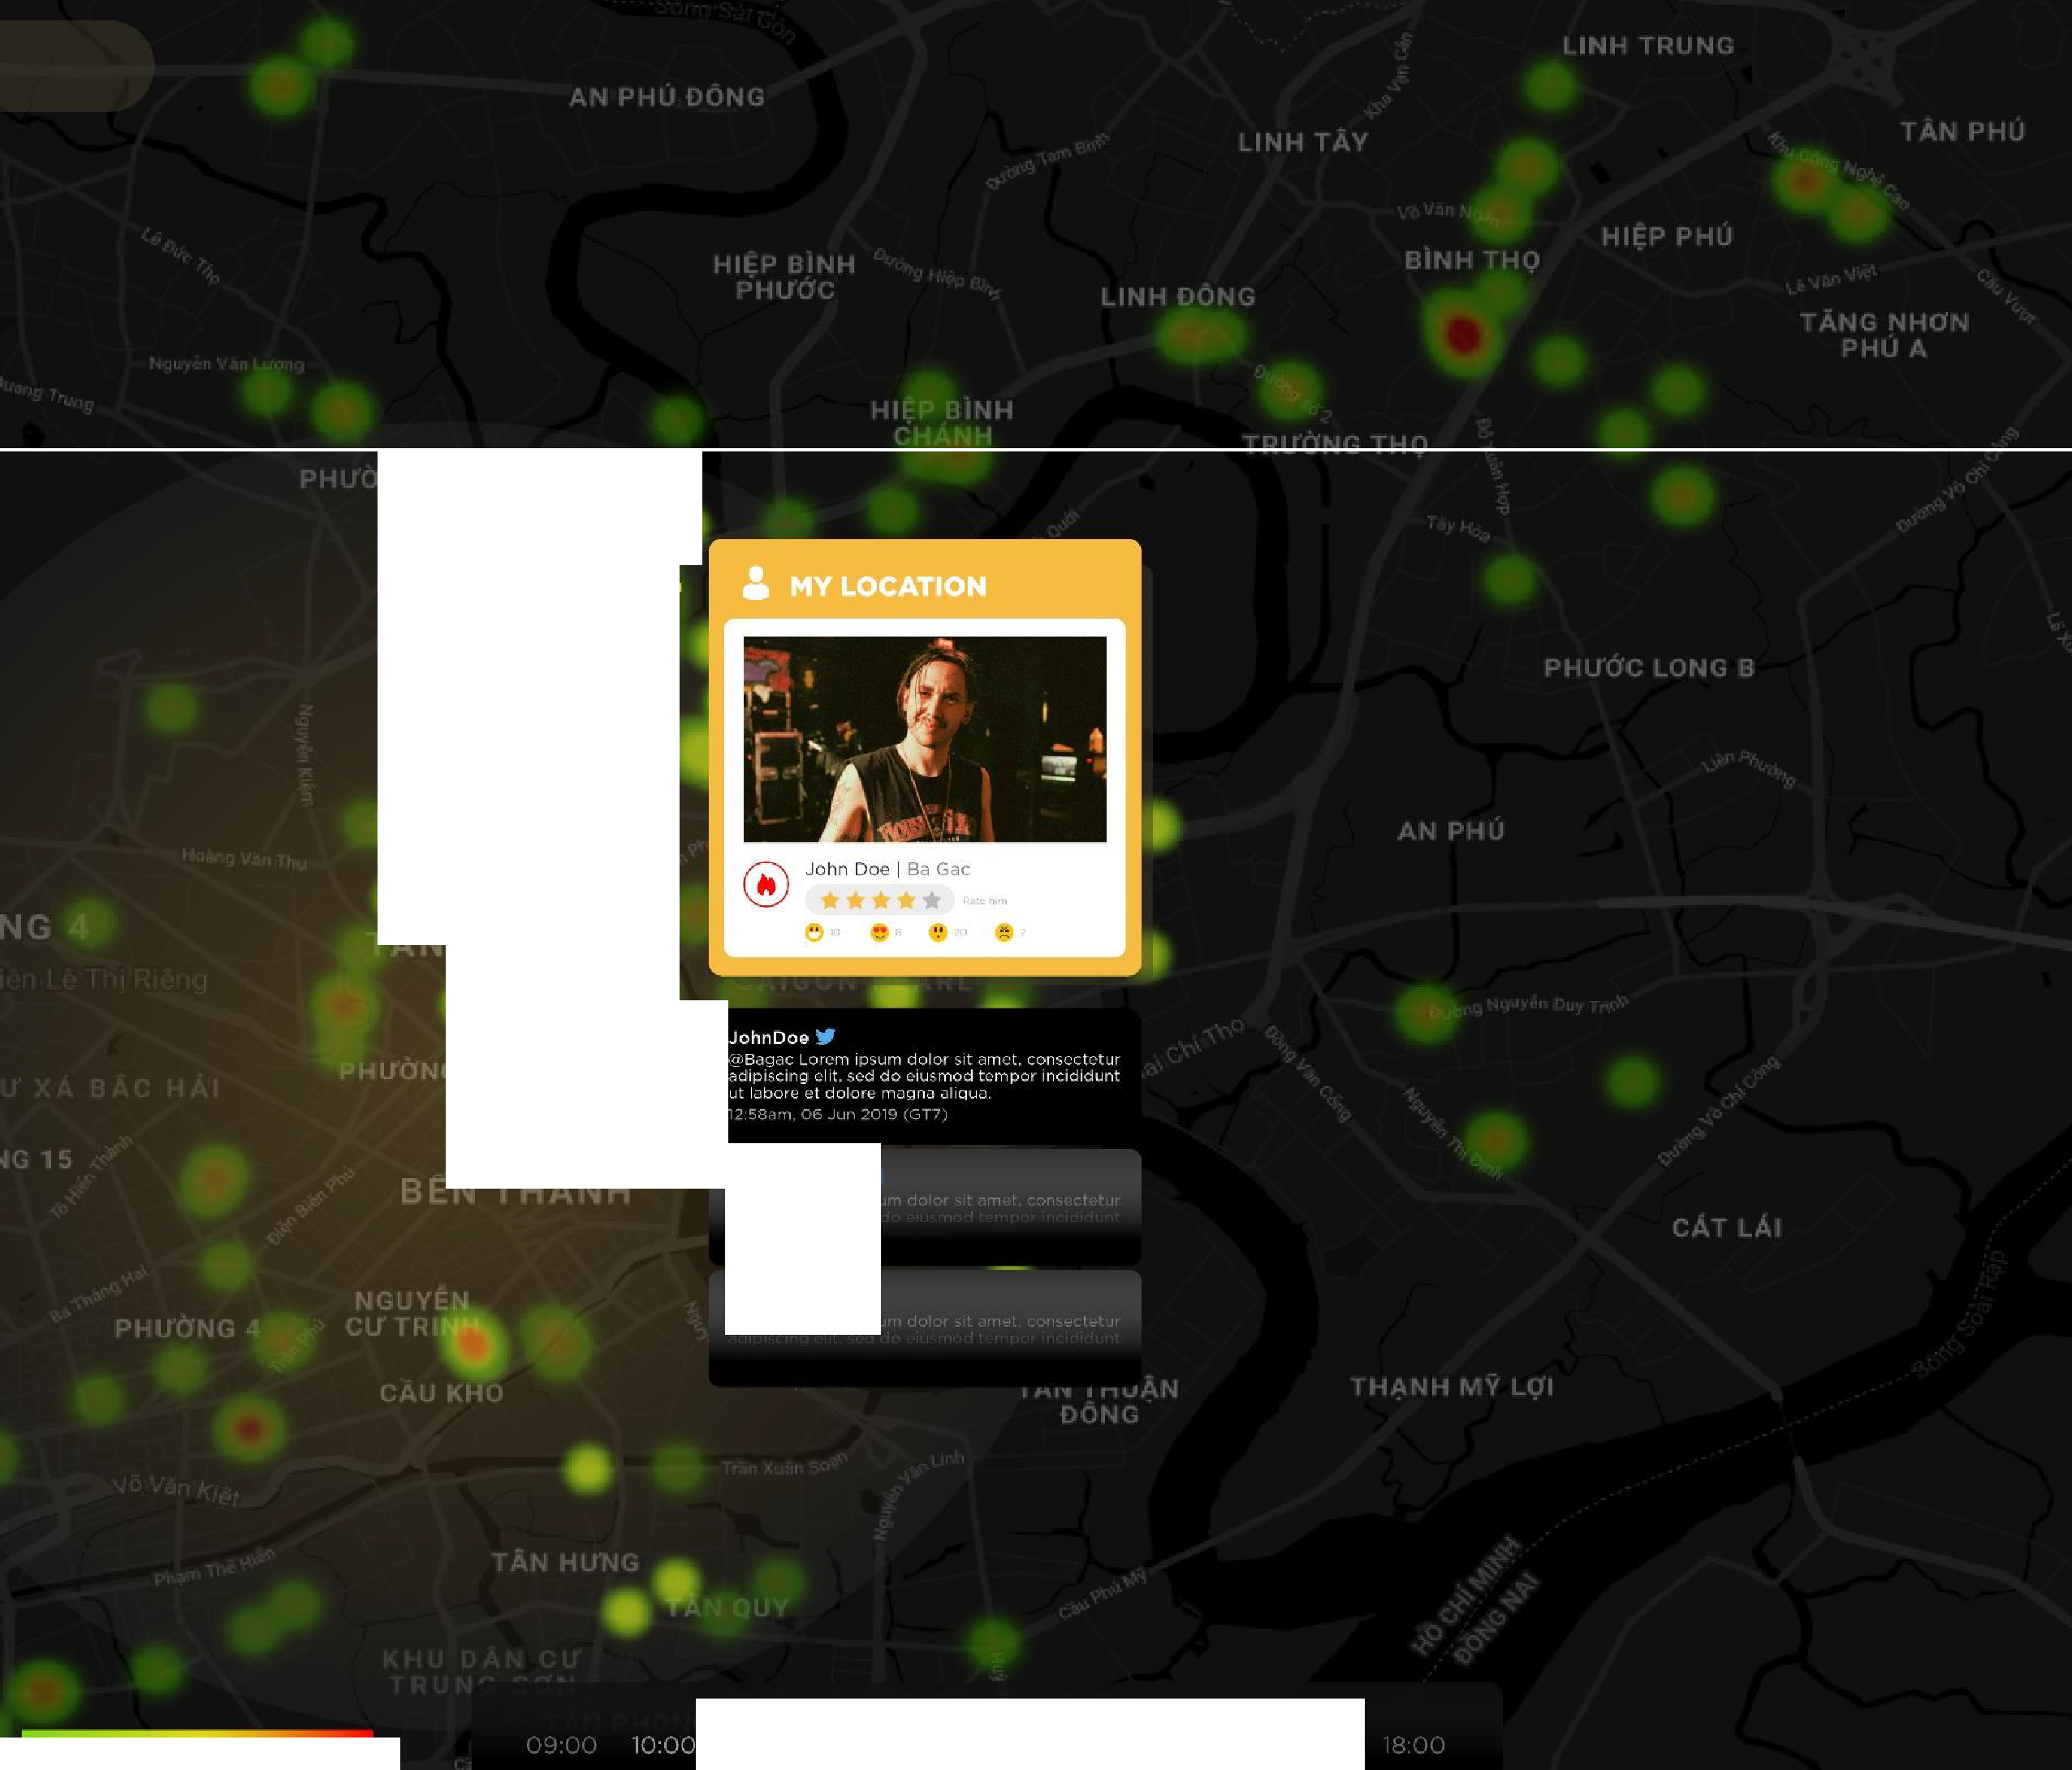










-182 No Tr.:Jng Long, Phuong 13,
Binh Than h, Ho Chi Minh , Vie tna m
4.07 km
Ca Nuong 539 PVD
5-11 Pha m Vcin Dong , Ph uo ng 1.3, Binh Thanh, Ho Chi Minh, Vietnam
4.42 km
0
-
C
•
1
•
A
"'
•
•
■
Quan 85
85 Le Duc Tho, Phuong 7.
Go Vap , Ho Chi Minh,
Vie tn i'tm
-5.52 km
•₋
Beer Zone
26 Le Duc Tho, Phuong 5, Go Vap, Ho Chi Minh, Vietnam
-5.57 km
t1
m
Oc Nho Sa1 Gon
02 Duang So 20, Hiep Binh Chanh Thu Duc, Ho Chi Minh,
Vietmim
5.68 km
•
n
Vong Xoay 1 Quan
95/3 Kha Van Can, Hicp Binh Chanh Thu Duc, Ho Chi Minh,
Vietnum
6.22 km
•
:::c
202 Ta Hieu
202 Ta Hieu, Phu Thanh Tan Phu, Ho Ch1 Mmh, Vietn;:im
-7.16 km
0
JohnDoe
•
m
210 Nguyen Duy Trinh Q2
210 Nguyen Duy Trinh, Binh Trung Tuy.
Quan 2, Ho Chi Min h ,
Viotnam
7.75 km
Johnnnn0/09 f
m
Tron Vo
18 Duong 270, KCD Nam Hoa, Quan 9, Ho Chi Minh, Vietnam
-9.31 km
MariaRosa
_
::a
-
1007
1005 Nguy1m Trai. Phuong 1'1,
Quan 5, Ho Chi Minh, Vie tnam
-5.69 km
■
0
11:00 1
12:00 Tuesday
15:00 16:00 -' u,_,
L-:, .,, crowdl.'d
More; crowdcd
1
13 :0 0
14:0 0

Slide 10



















SCOPE
* Modeling is carried out with R-square .80.
Mexico City 80 Bartenders / 30 Bars
Win 2 CHEERCOINS with BRAND X
5 days
SCHEME
RESULT
The campaign was able to significantly grow the brand & resulted with a halo effect on the total performance of the brand X portfolio
BARTENDER PRODUCTIVITY
(Total Bottles
/ Bartender)
INCREMENTAL VALUE (USD)
INCREMENTAL
VOLUME (bottles)
BARTENDER
ENGAGEMENT
BRAND X MARKET SHARE
CAMPAIGN ROI*
CAMPAIGN SPENDING (USD)
TOTAL BREWERY MARKET SHARE
*Based on a 75% Marginal Contribution estimation

Slide 11

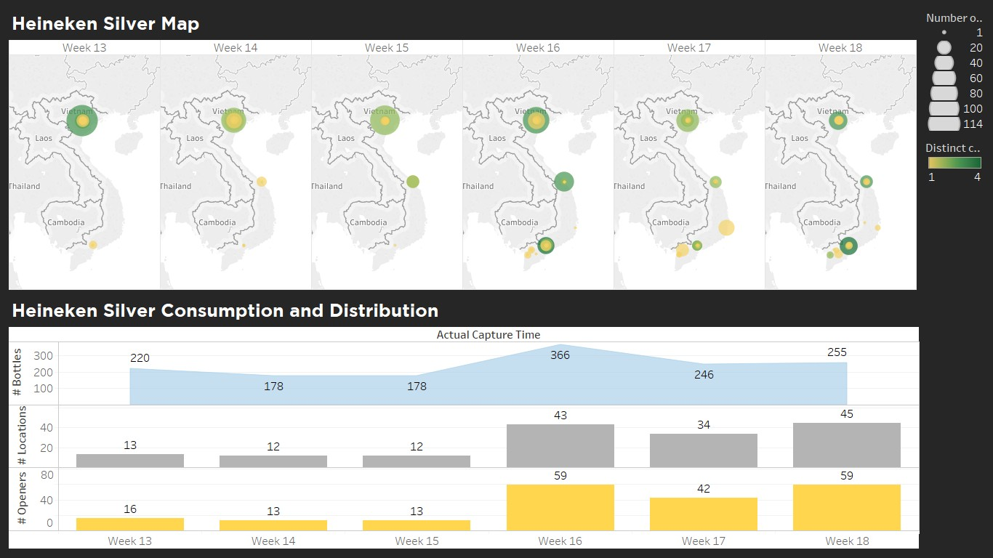
SCOPE
DETECT NEW BRANDS BEFORE LAUNCH
BRAND Y
LAUNCH EVOLUTION
Vietnam
Since 27th
of March
BRAND Y CONSUMPTION AND DISTRIBUTION

Slide 12

010101
00110011
0 01 i100001100
BREWINC DATA ONE BOTTLE AT ATIME
- - - - - - - - - - - - - - - - - - - -
100Cl10 0 0 110 0 0 1
0 1c 0110101111
0 01010 0 01100 0
10 0 010 0 110 01
0 0 110 0 010 10 1
110 1010 10 0 01
0 10 10 110 0 10
110 1010 10 10 1
0 110 10 10 110 1
1010 11010 110
010 1110 110 01
- , 1 0 ¹1 0 1111¹⁰0¹⁰111 0⁰
0011011011010
1101010110101

